Slide 1
(Advance Programming Practices )
SOEN-6441
( Summer-2 , 2019 )
BattleShip Game
By:
Arslaan-
Mridul-
Sagar-
Prateek-
Mehak jot kaur - 40070845

Slide 2
Problem Statement
Building a super duper Battleship Board game using java as a programming language.
There will be two players.
Computer
User
Goal- To sink opponent’s all the Ships .

Slide 3
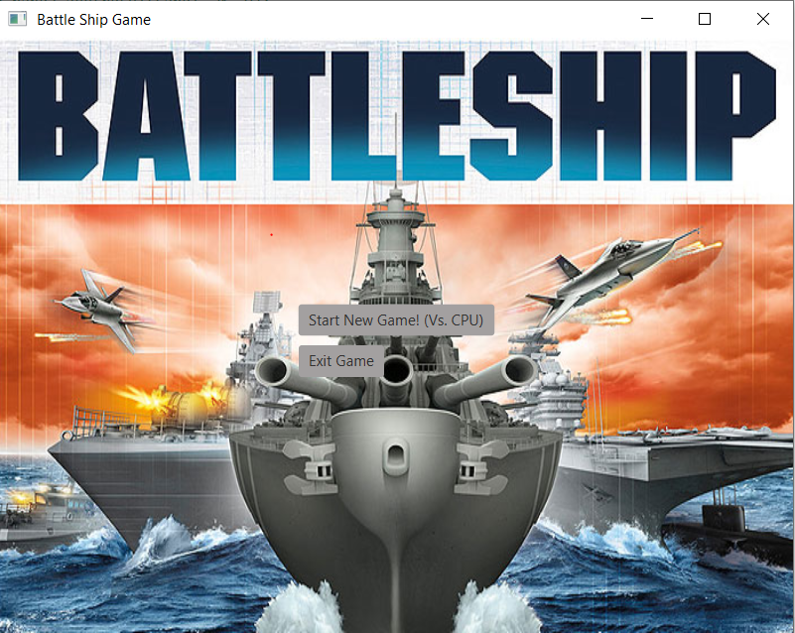
Screenshots of Game

Slide 4
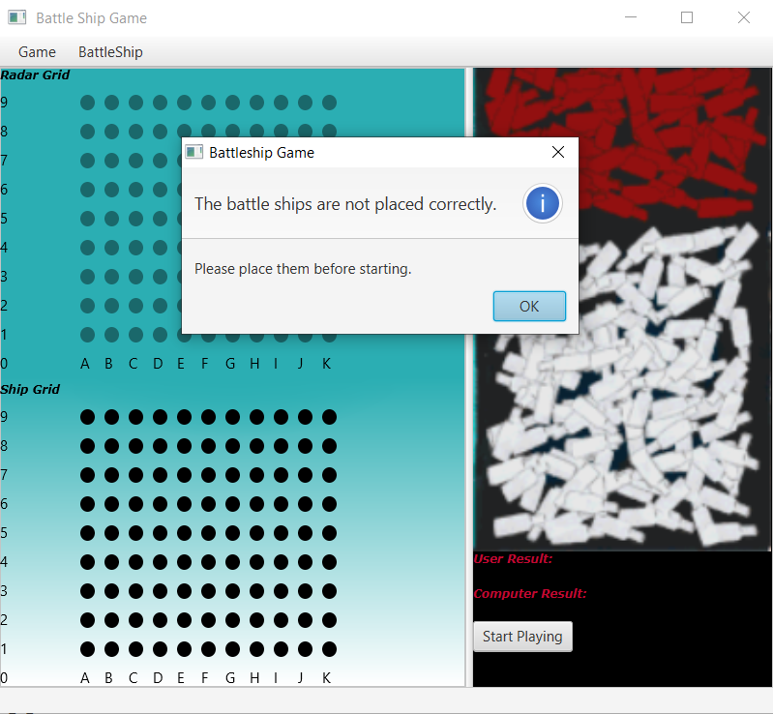
Before start playing battleship game between computer and user. User needs to place ships correctly on the ship grid.

Slide 5
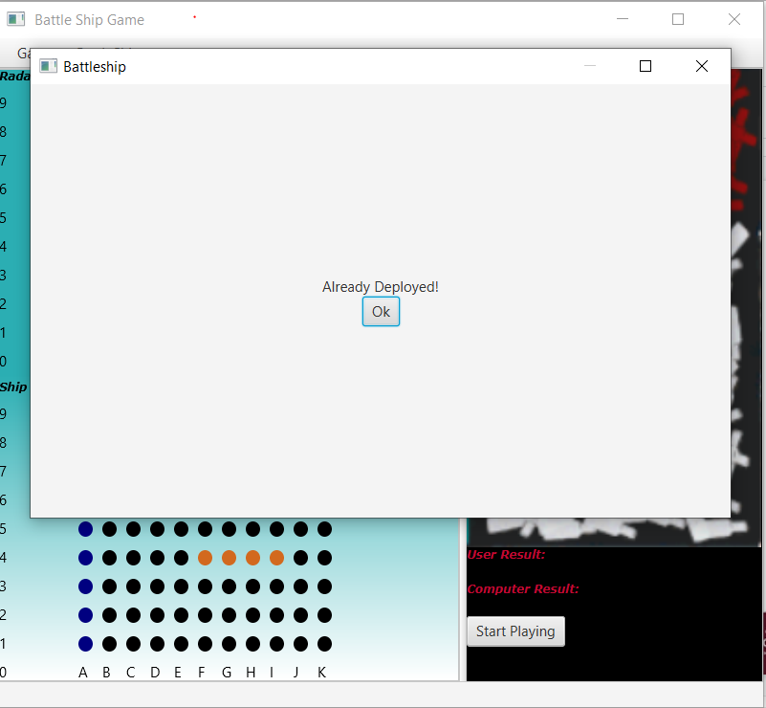
Alert Box if Ship is already deployed on the ship grid.

Slide 6
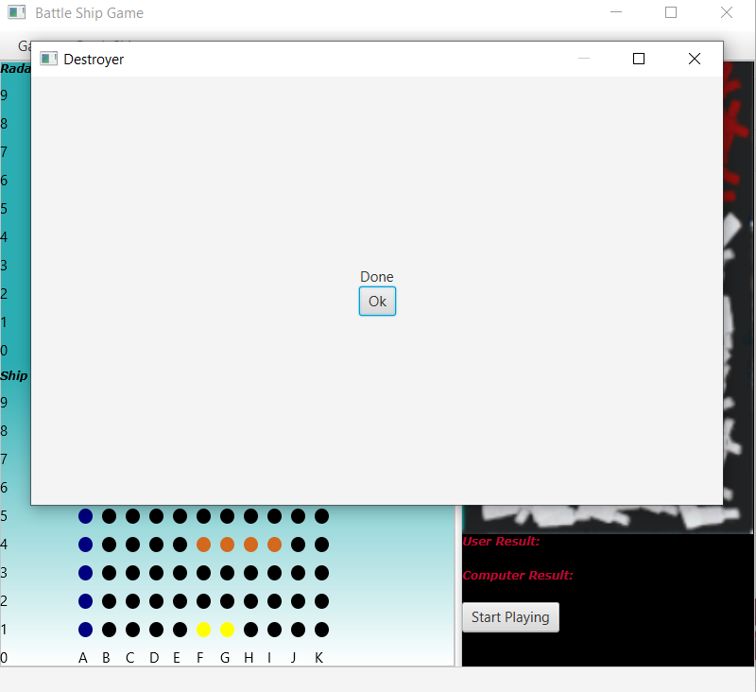
When all the ships are deployed on the ship grid by user so it will show alert box like this.

Slide 7
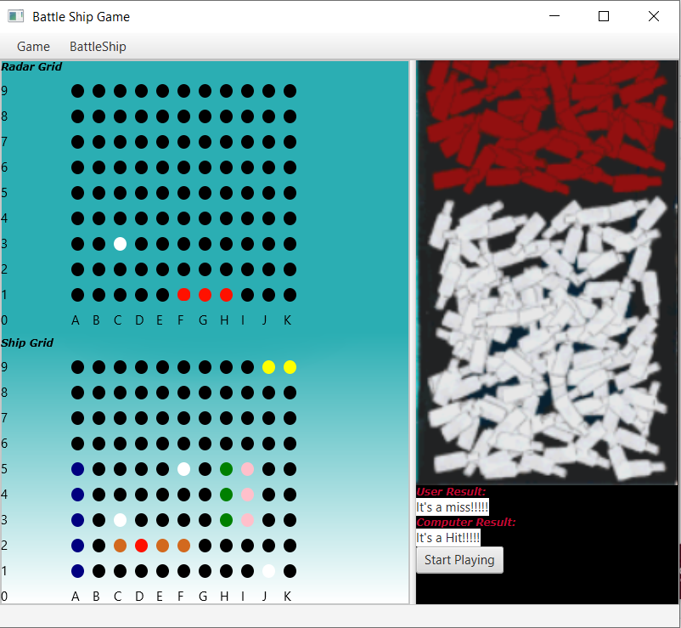
Computer and user are playing game. Red colour is showing hit whereas White colour is showing miss.

Slide 8




Technical Specifications

Slide 9
c
Coding Conventions
Coding Conventions are the defined set of rules that tells how code is to be written. we used following coding conventions in our project.
Type | Notation Followed
Class Name | UpperCamelCase
Method Name | LowerCamelCase
Constant Name | Constant_Case
Parameter Name | lowerCamelCase
Package Name | all Lowercase

Slide 10
Challenges Experienced
The main challenges faced during build:
Time Management
Scope of the project
Team Meetings
Technical issues came while solving errors

Slide 11
References:
REFERENCES:

Slide 12
THANK YOU

